Slide 1
Homochiral ideas
Marianne Imperor-Clerc
March 2026

Slide 2
Homochiral python code on github
https://github.com/marimperorclerc/homochiral
python code for drawing clusters with Tile(a,b) in svg graphics
References
Code is based on the drawsvg package:
https://pypi.org/project/drawsvg/
And the python code with alternate chirality for inflation for spectre tiling:
https://github.com/shrx/spectre/blob/master/spectre.py
Adapted here (spectre-colored-tiles.ipynb) with different color choices
See some .svg files in \svg-spectre folder

Slide 3
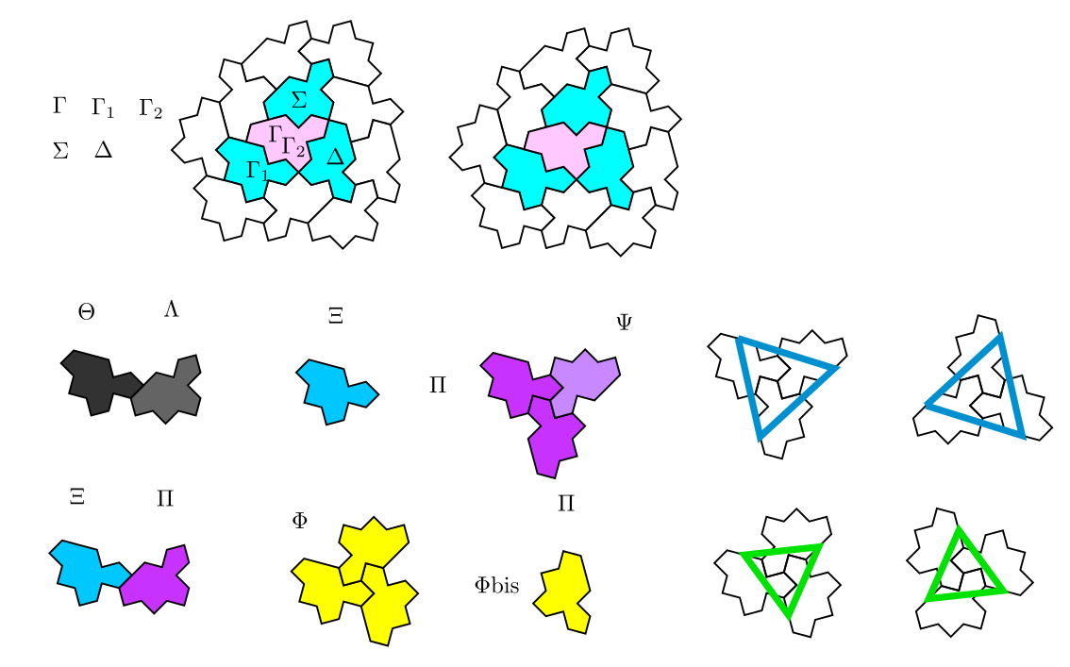
Identification of the greek letters for tiles
Consider a cluster of four tiles instead of 3 for horn in the anatomy ? (by adding the \Delta tile)
Large stars correspond to all \Pi and \Psi tiles
\theta and \lambda always in couple
\phi tiles give all small stars plus isolated ones. Look at the position of the isolated ones (called here \phi_bis) ?
All \chi tiles are linked to a \pi tile and consequently to a large star.

Slide 4
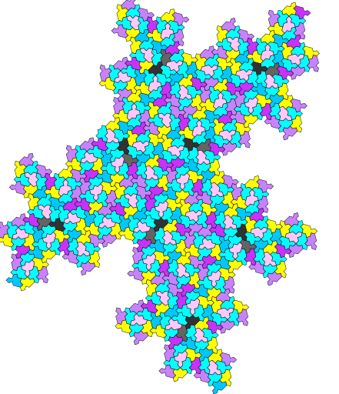
Third inflation with color code from greek letters
\theta and \lambda always in couple -> part of a propeller
Large stars correspond to all \Pi and \Psi tiles
\phi tiles give all small stars plus isolated ones. Look at the position of the isolated ones (called here \phi_bis) ?

Slide 5
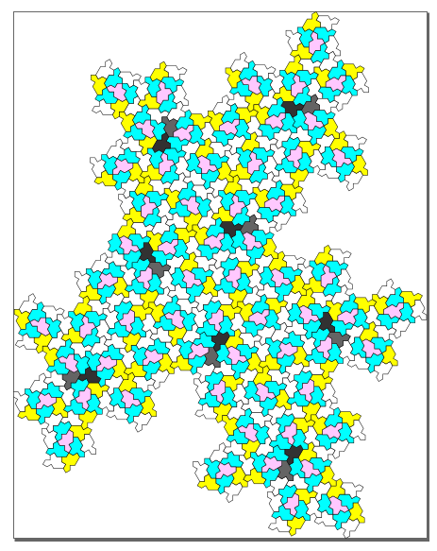
Another version with less colors …
\theta and \lambda always in couple -> part of a propeller
Large stars correspond to all \Pi and \Psi tiles
\phi tiles give all small stars plus isolated ones. Look at the position of the isolated ones (called here \phi_bis) ?

Slide 6
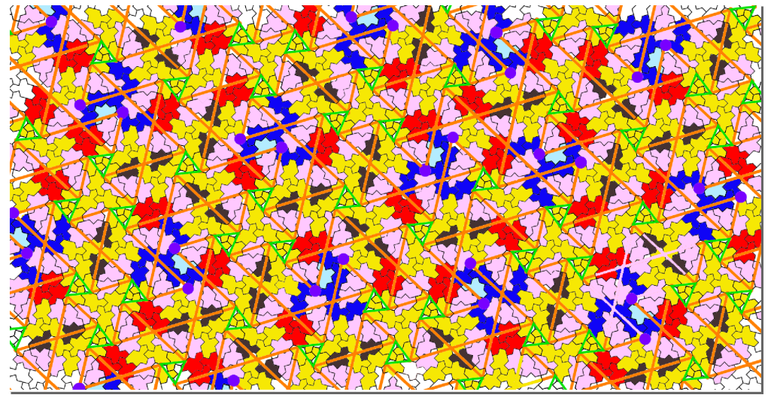
Link with anatomy by Boris Horvat ?

Slide 7
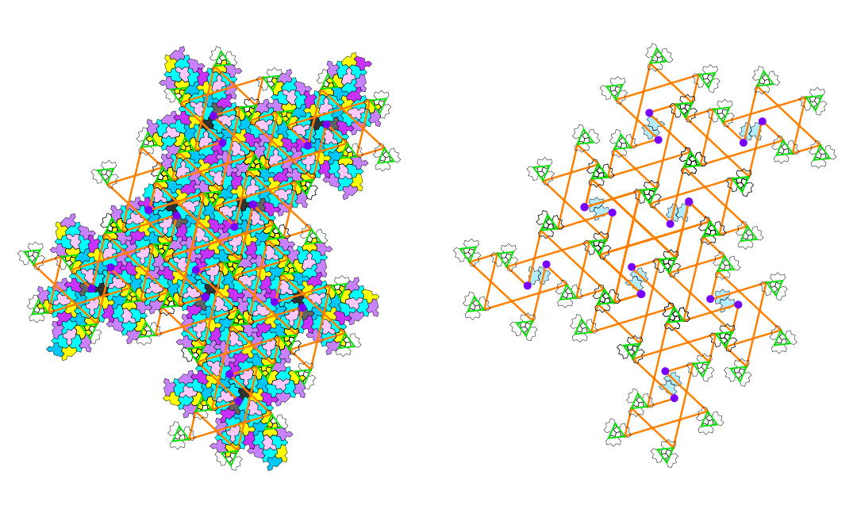
Third inflation: identification of the 2-arms, 3-arms and diabolos

Slide 8
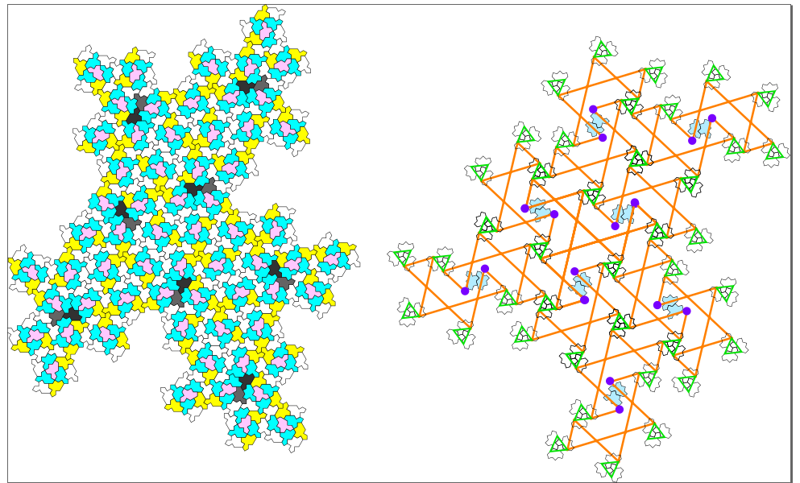
Another version with less colors …
\theta and \lambda couple -> part of a propeller -> highlight a specific configuration of two full clusters !

Slide 9
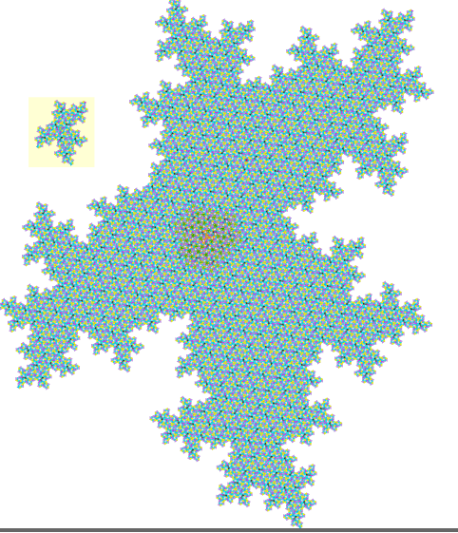
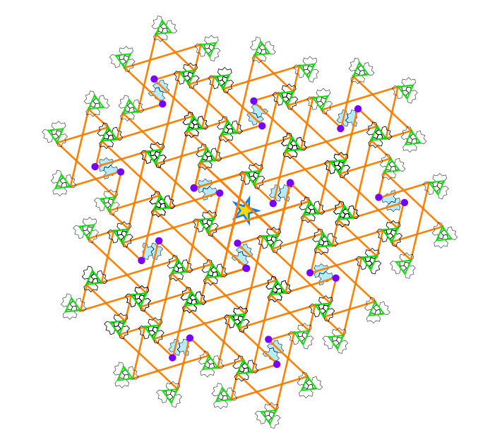
Third to fifth inflation: identification of the 2-arms, 3-arms and diabolos …
Very long to do by hand !!!

Slide 10
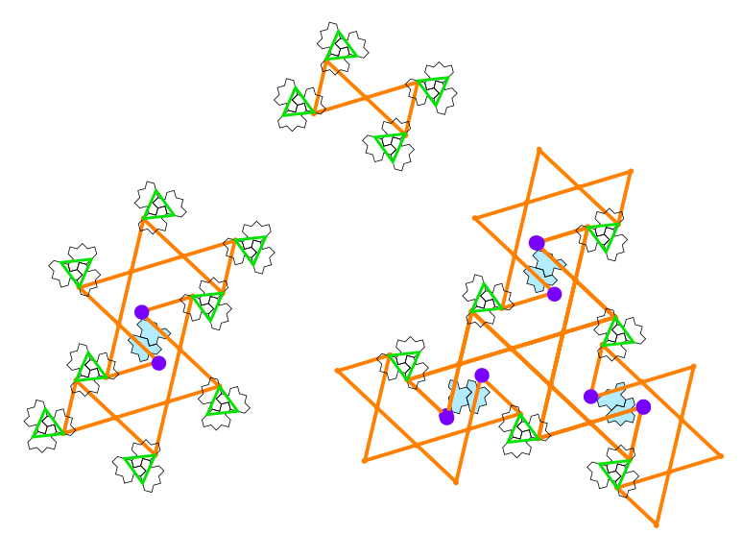
New puzzle

Slide 11
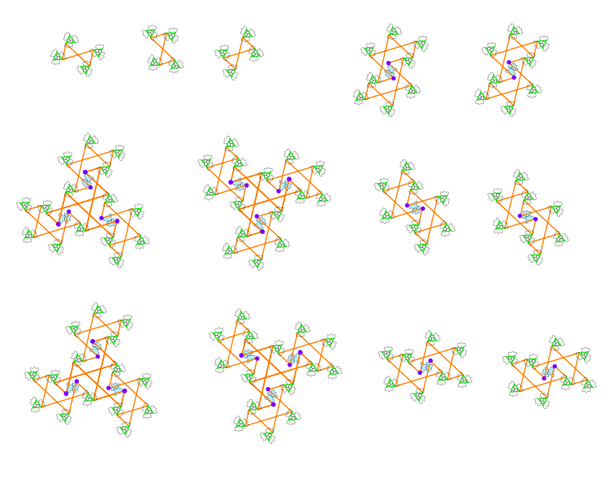
New puzzle

Slide 12
Homochiral assembly rule from these pieces ???

Slide 13
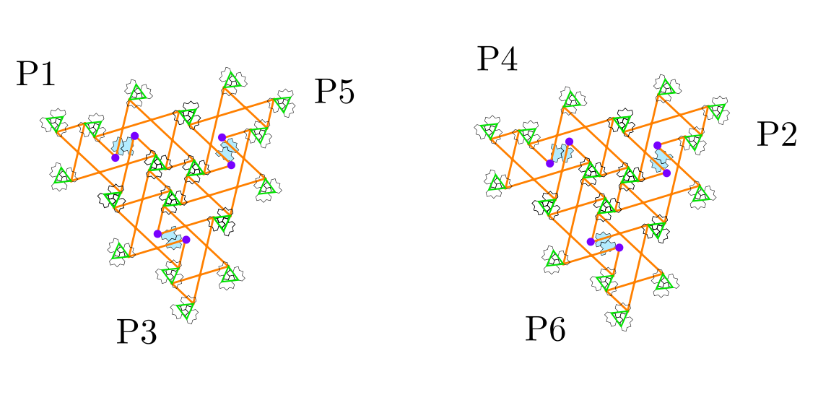
Possible candidate for a seed ?
Three 2-arms combined in this way:

Slide 14
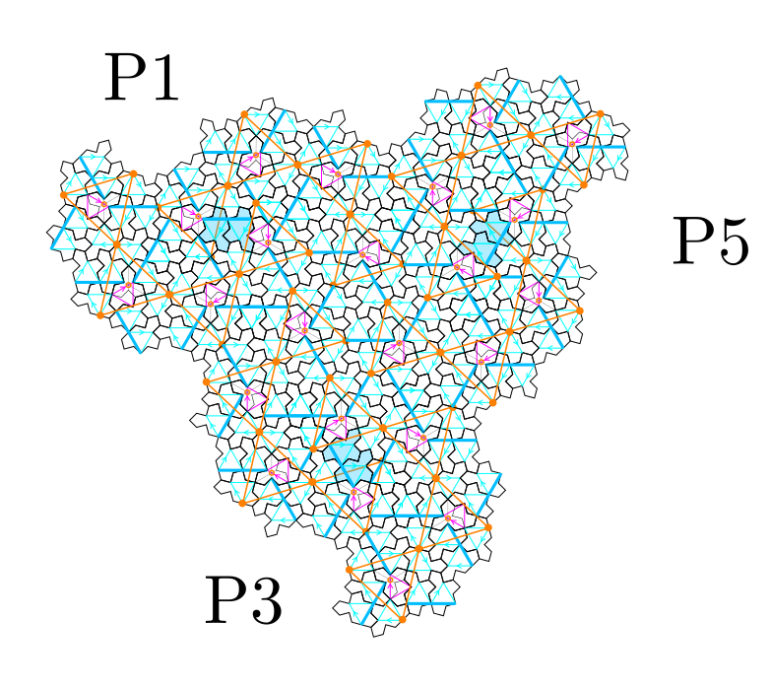
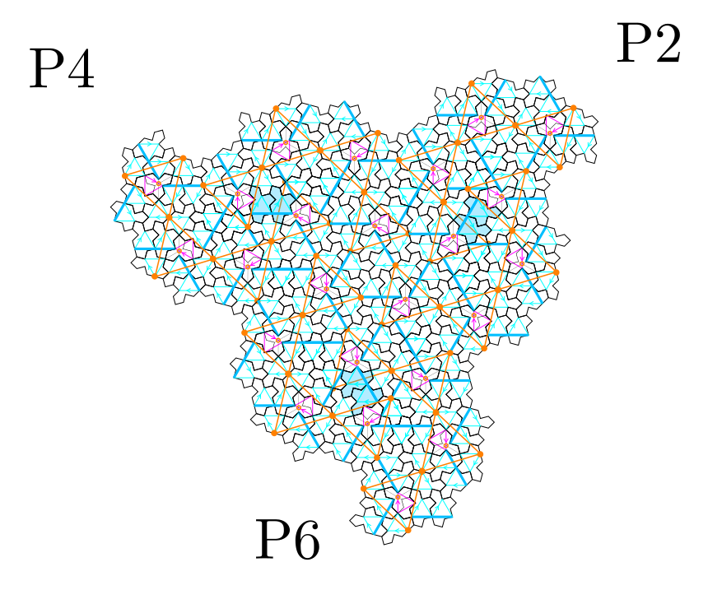
Possible candidate for 3-fold symmetry center
Compare with center of giant star cluster by Boris Horvat ???
True three fold symmetry point at center ???

Slide 15
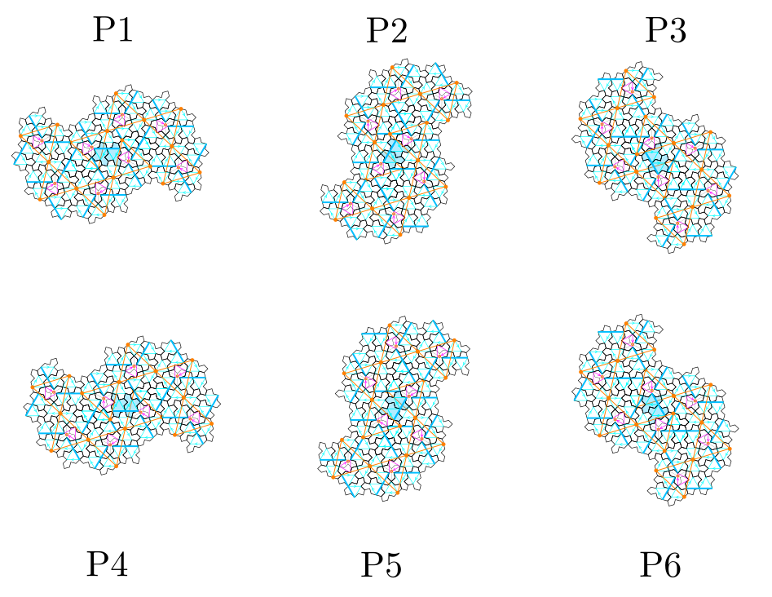
Six orientations of the 2-arms

Slide 16
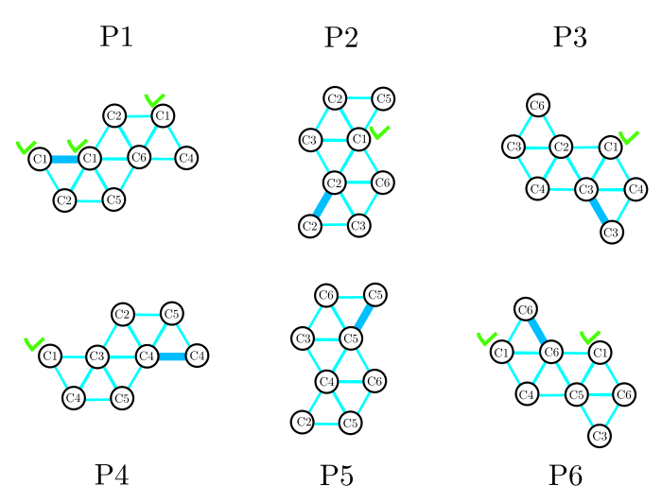
Six orientations of the 2-arms

Slide 17
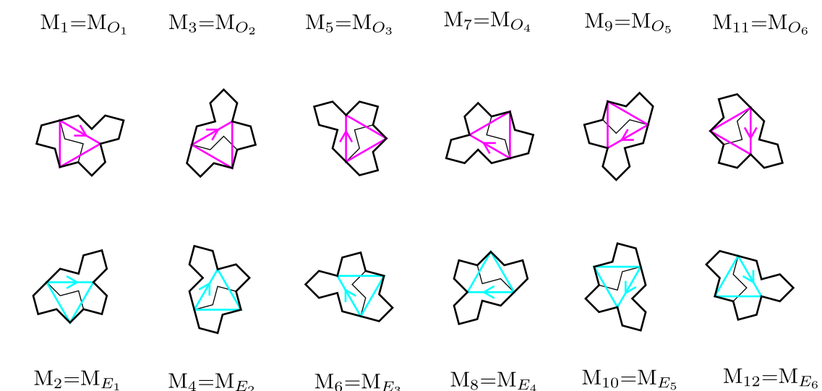
ODD and EVEN orientations for Tile(1,1)

Slide 18
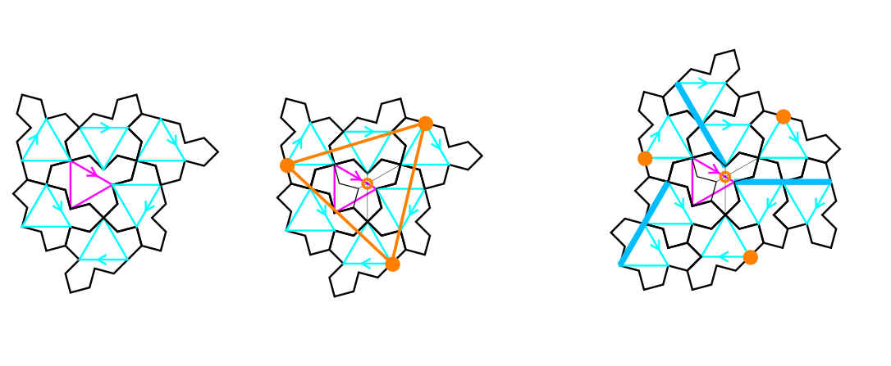
full cluster
Tile(1,1)
C cluster: one ODD tile at the center + 6 EVEN tiles around
Three glue points (orange color): regular triangle centered on the trifle shape of the ODD tile
Full cluster: 3 more EVEN tiles obtained by translations (three dark blue lines)

Slide 19
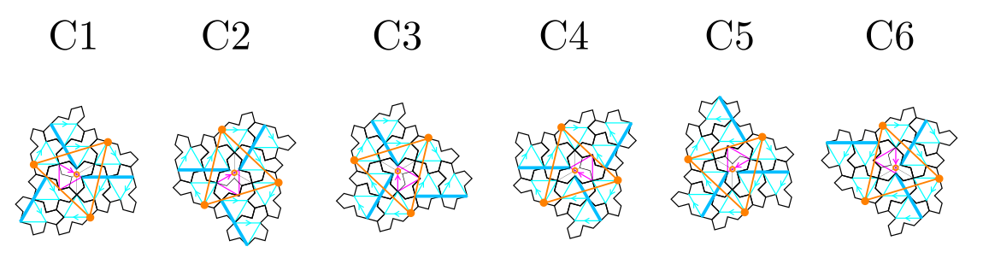
full cluster with its six rotations: n(2pi/6)
Tile(1,1)
13 tiles in a full cluster: one ODD tile at the center + 9 EVEN tiles around
Blue triangles (EVEN) have one horizontal edge when pink (ODD) have a vertical one

Slide 20
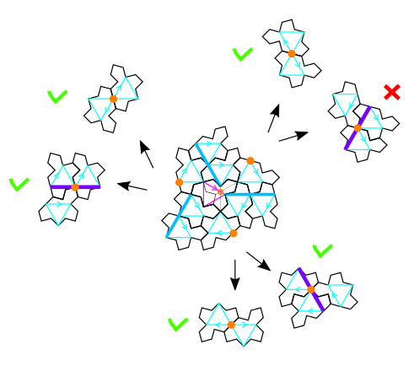
Possible configurations at the glue points ?
Half-turned or translated monotile (violet line)

Slide 21
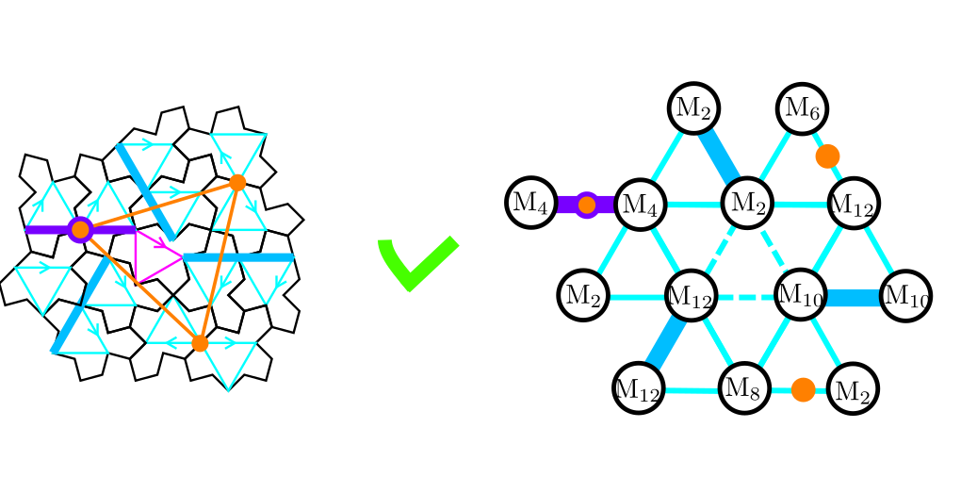
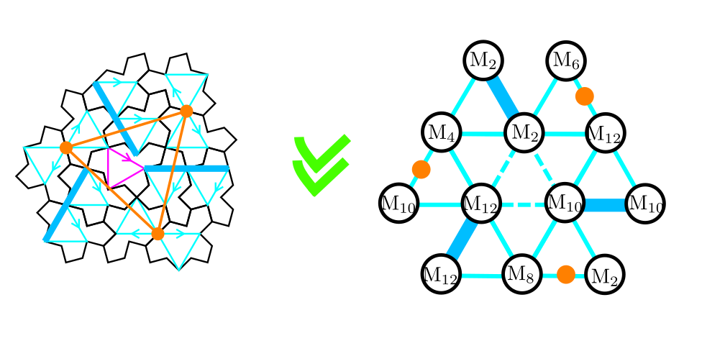
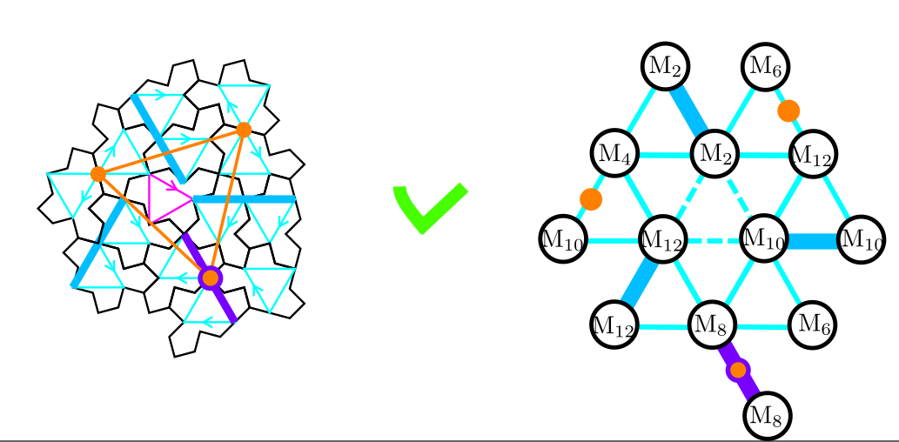
Three possible configurations at the glue points
configuration with three half-turned tiles is the most common
The other two are always coupled together in the tiling

Slide 22
Orientation of the EVEN tiles in the most frequent configuration
Tile(1,1)
6 tiles in the C-cluster (corona made of M12, M4, M2, M12, M10, M8)
3 translated (M2, M10, M12) (along blue lines, the edges of blue triangles)
3 half-turned (M4->M10, M12 -> M6, M8 -> M2)

Slide 23
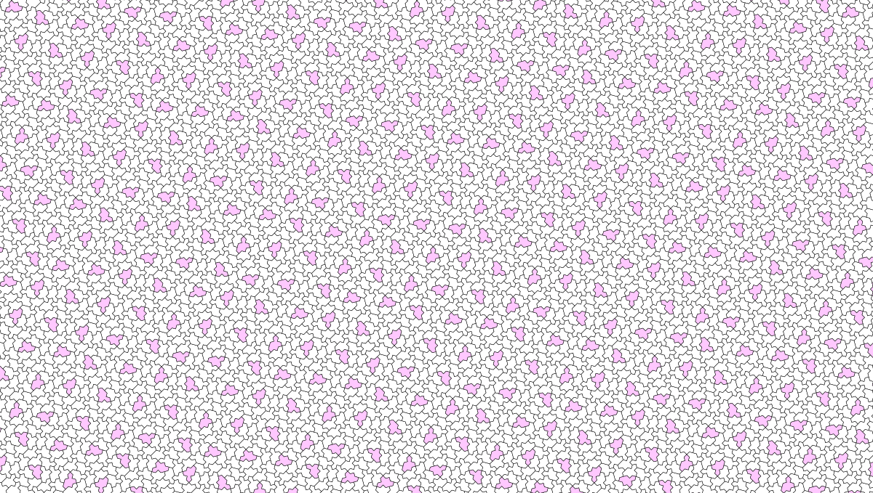
Construction for the whole tiling ???

Slide 24
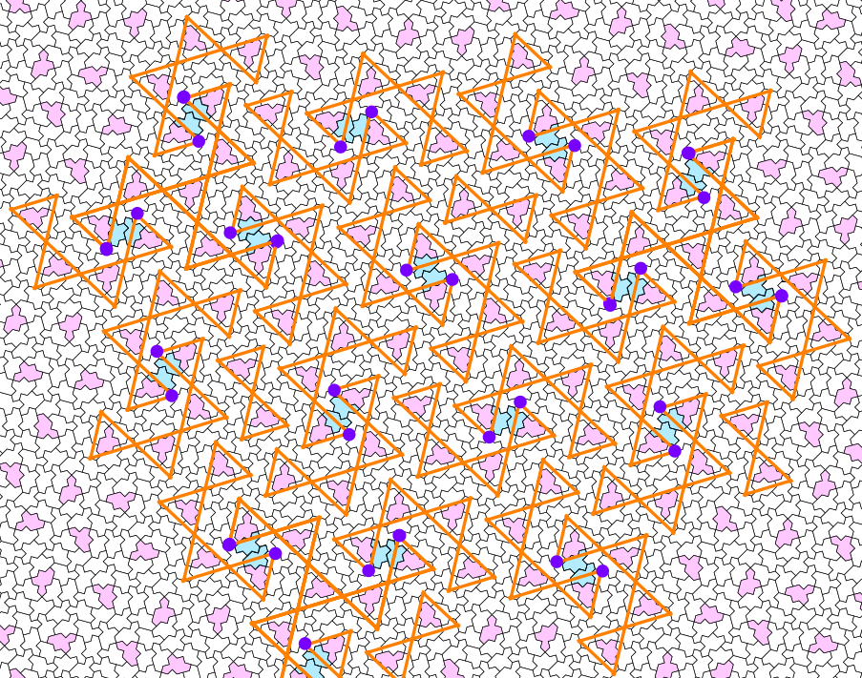
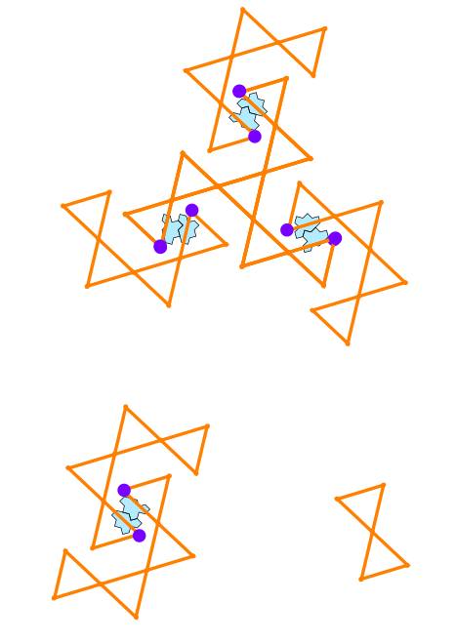
Three patterns in the whole tiling ☺
3-arms
diabolo
2-arms

Slide 25
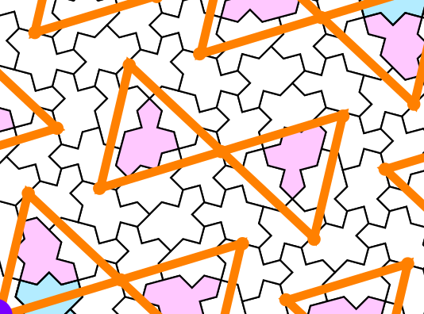
Diabolo pattern

Slide 26
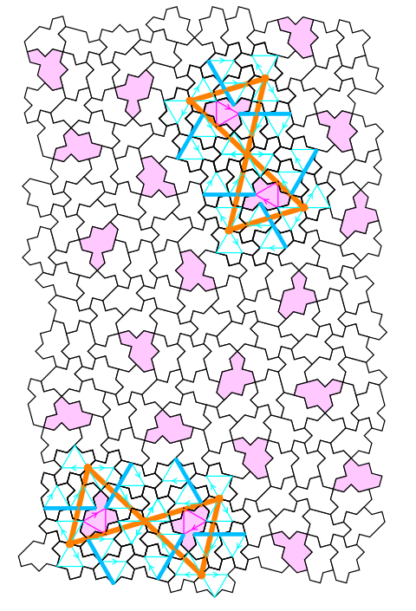
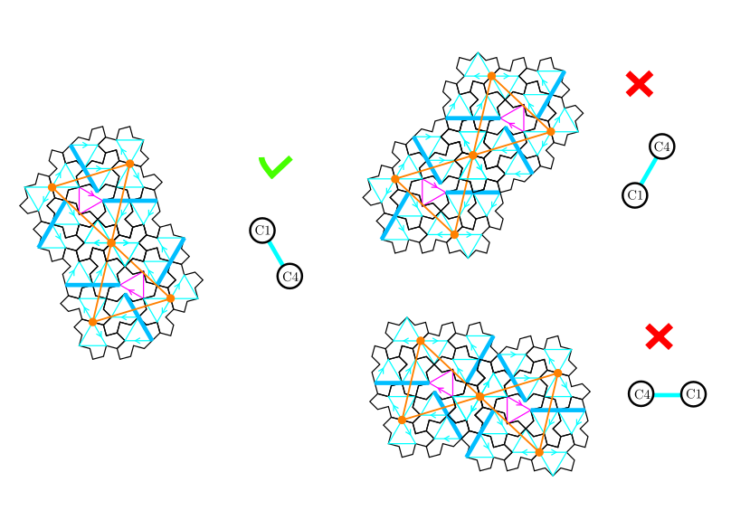
Diabolo pattern

Slide 27
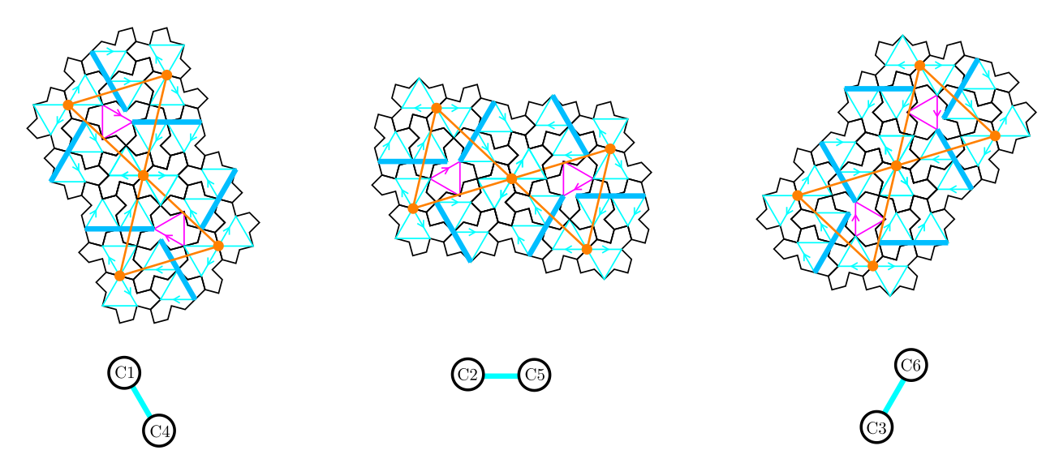
Diabolo pattern
Three orientations of the same diabolo pattern

Slide 28
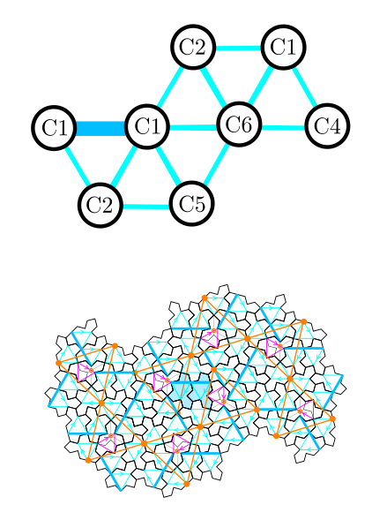
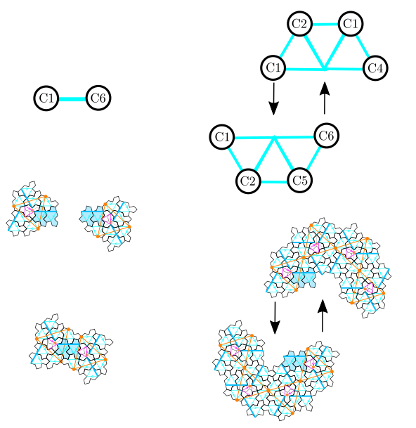
Two-arms chiral pattern
Two ‘croissants’ of 4 clusters
Two translated monotiles in the middle + superposition of glue points
Easy to code ! ☺

Slide 29
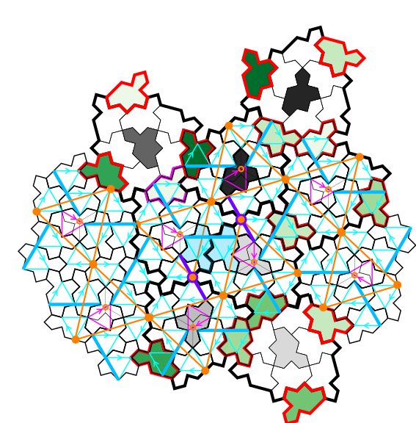
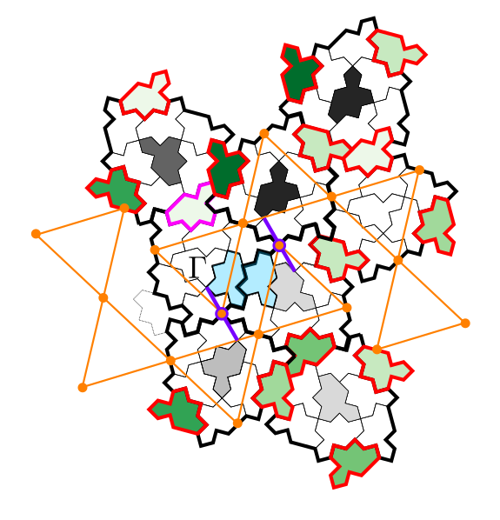
Link with triangular pattern
The two other environnements with a violet lines are always coupled together

Slide 30
Six orientations of the 2-arms

Slide 31
Six orientations of the 2-arms
8 combinations for a given cluster orientation (green crosses)

Slide 32
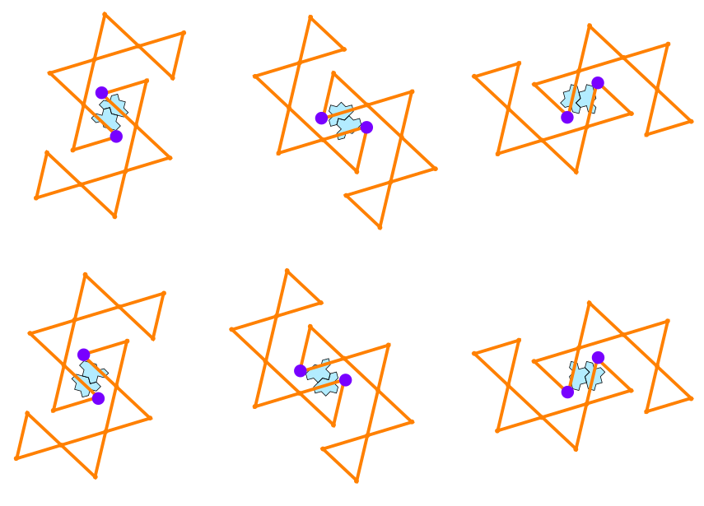
Six orientations of the 2-arms

Slide 33
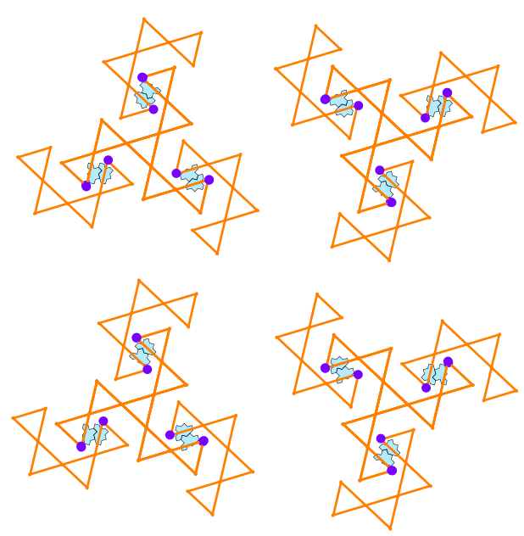
four orientations of the 3-arms

Slide 34
New puzzle

Slide 35
New puzzle

Slide 36
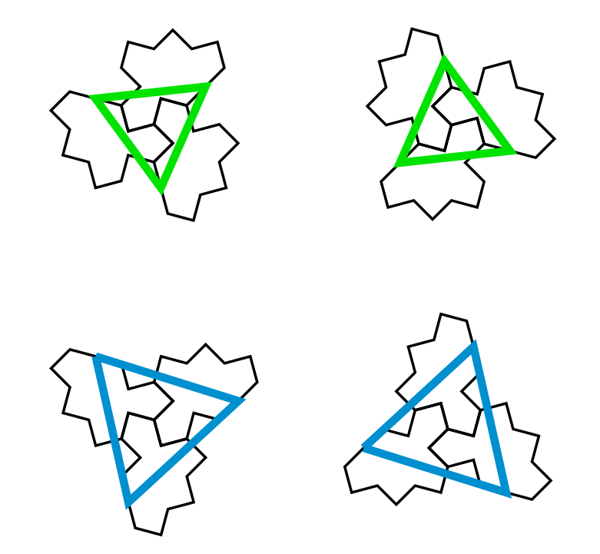
stars
Small and large stars with two possible orientations

Slide 37
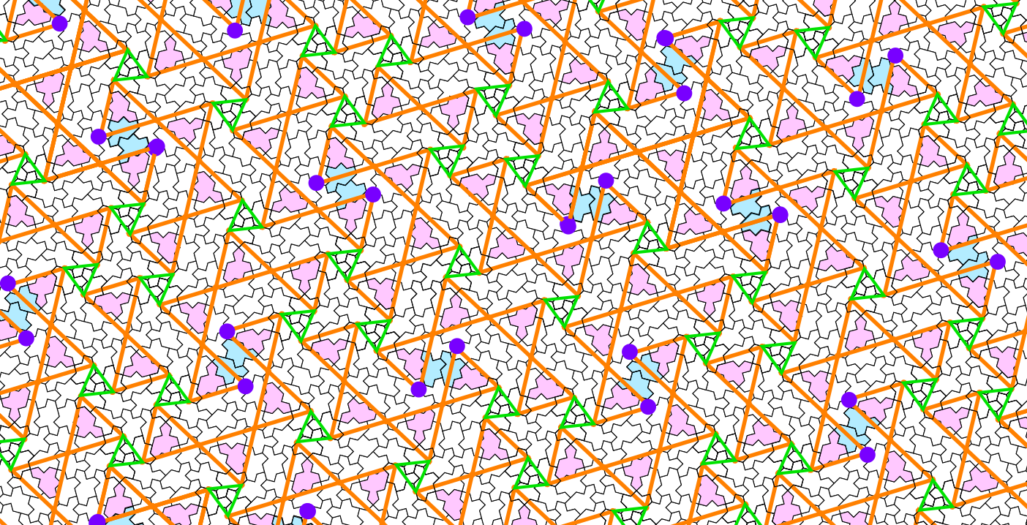
Small stars connect the orange triangles
Possibility to obtain the relative positions between diabolo, 2-arms and 3-arms

Slide 38
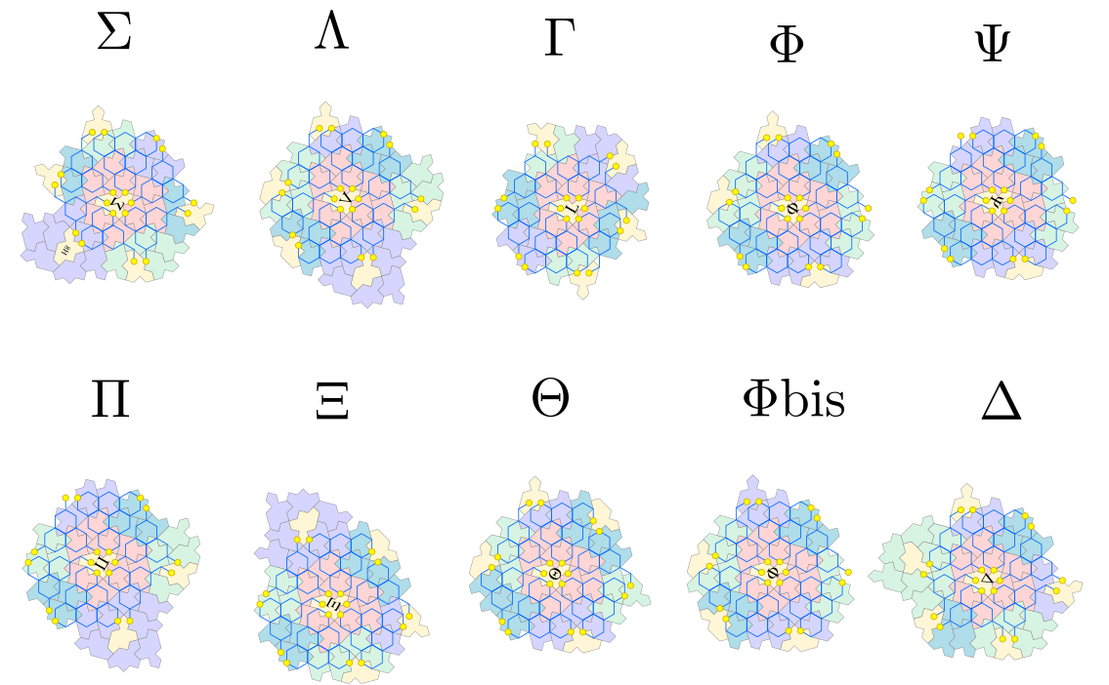
10 environments (C1 orientation)
Left handed version of the figure in Arnaud’s paper.
Chéritat, A., (2024). Observations on the hex clusters of the spectre tilings. https://arxiv.org/abs/2407.05359

Slide 39
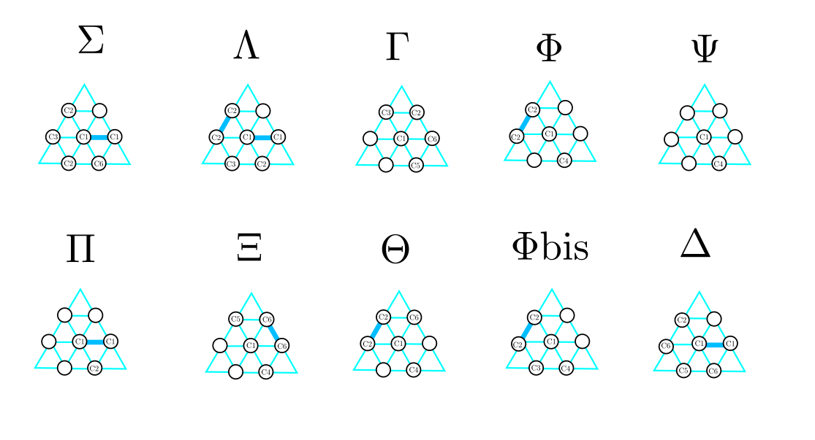
10 environments for C1

Slide 40
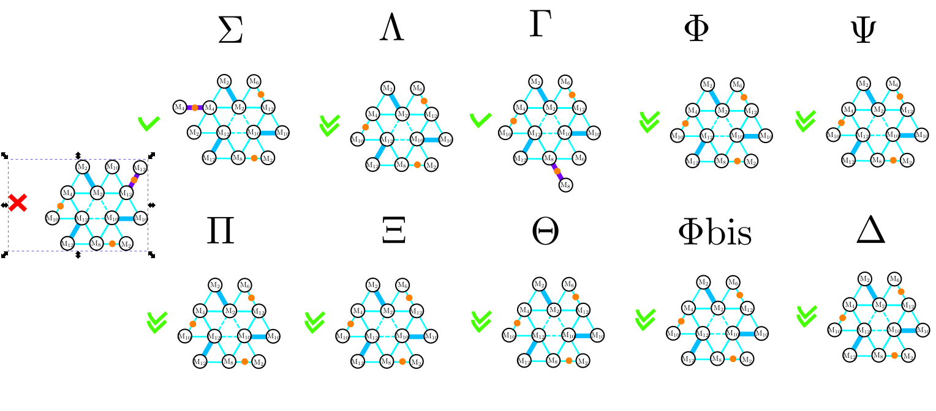
10 environments for C1

Slide 41
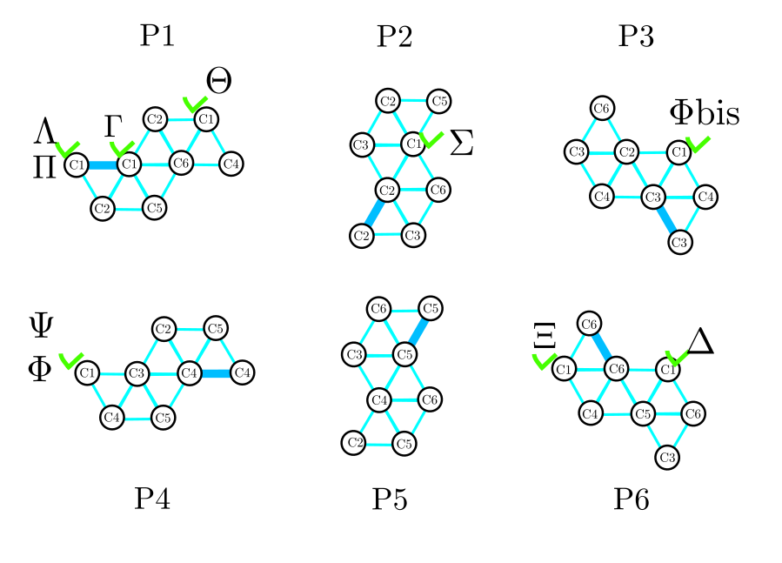
8 different locations in the chiral pattern

Slide 42
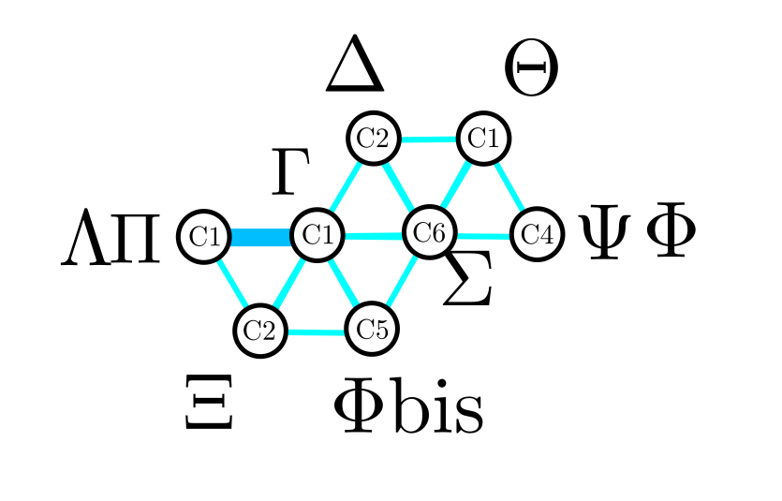
10 environments (capital greek letters)
Need to reduce to 8 environments ?

Slide 43
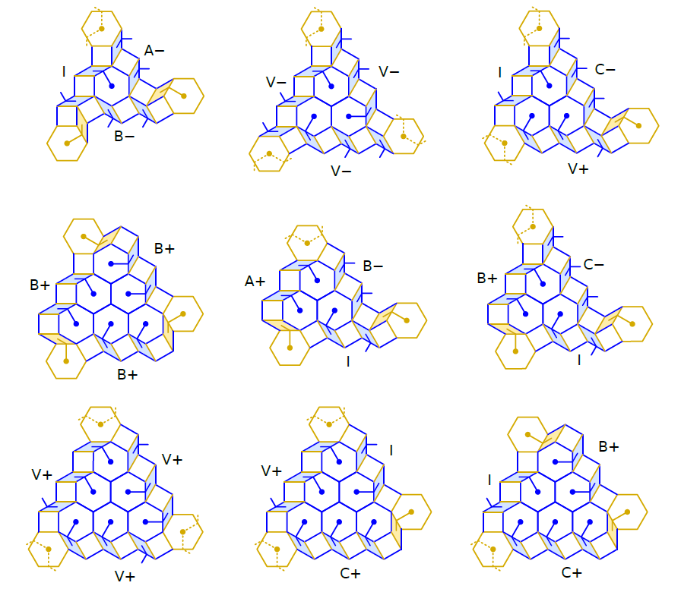

8 types of hexagonal clusters
To do:
Locate the 8 hexagonal clusters in the chiral pattern
Chéritat, A., (2024). Observations on the hex clusters of the spectre tilings. https://arxiv.org/abs/2407.05359

Slide 44
Homochiral python code on github
Under construction !
https://github.com/marimperorclerc/homochiral
python code for drawing clusters with Tile(a,b) in svg graphics.
References
Code is based on the drawsvg package:
https://pypi.org/project/drawsvg/
And the python code with alternate chirality for inflation for spectre tiling:
https://github.com/shrx/spectre/blob/master/spectre.py

Slide 45
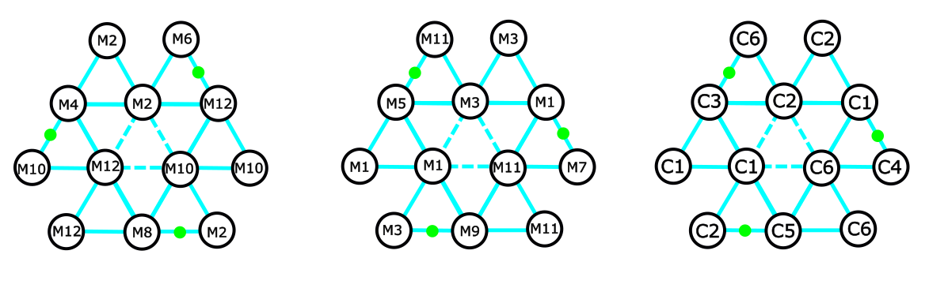
Inflation step 1: substitution rule for C1
EVEN tiles in C1
ODD tiles for step 1
same as full clusters
ODD tiles for step 1 are obtained by adding 1 (mod 12) to all EVEN tiles in the C cluster (6 tiles)
Directions of translated and half-turned tiles are exchanged (see the change of position for green points). Then three tiles are translated (M1, M3, M11) and three are half-turned (M5->M11, M1 -> M7, M9 -> M3)
ODD tile index is equivalent to the orientation of a full C cluster ☺

Slide 46
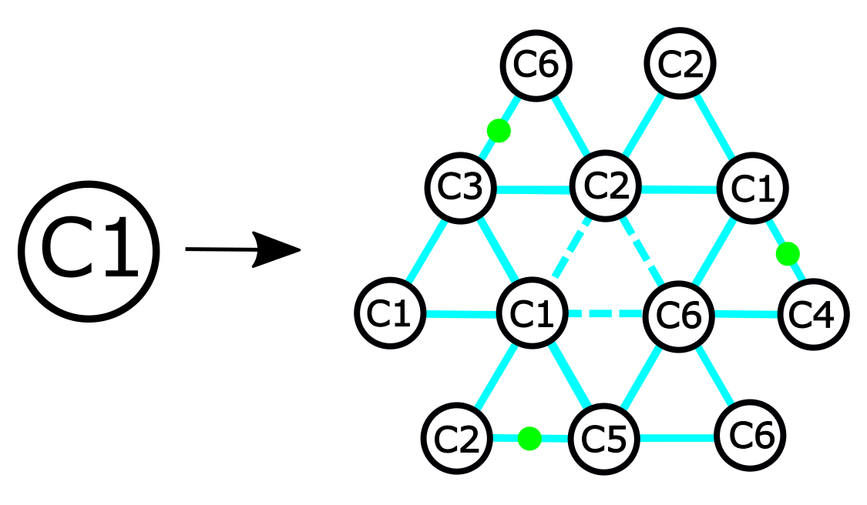
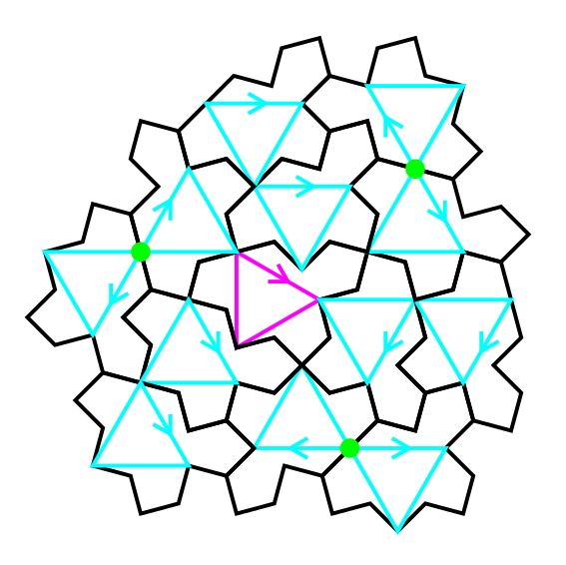
Inflation step 1

Slide 47
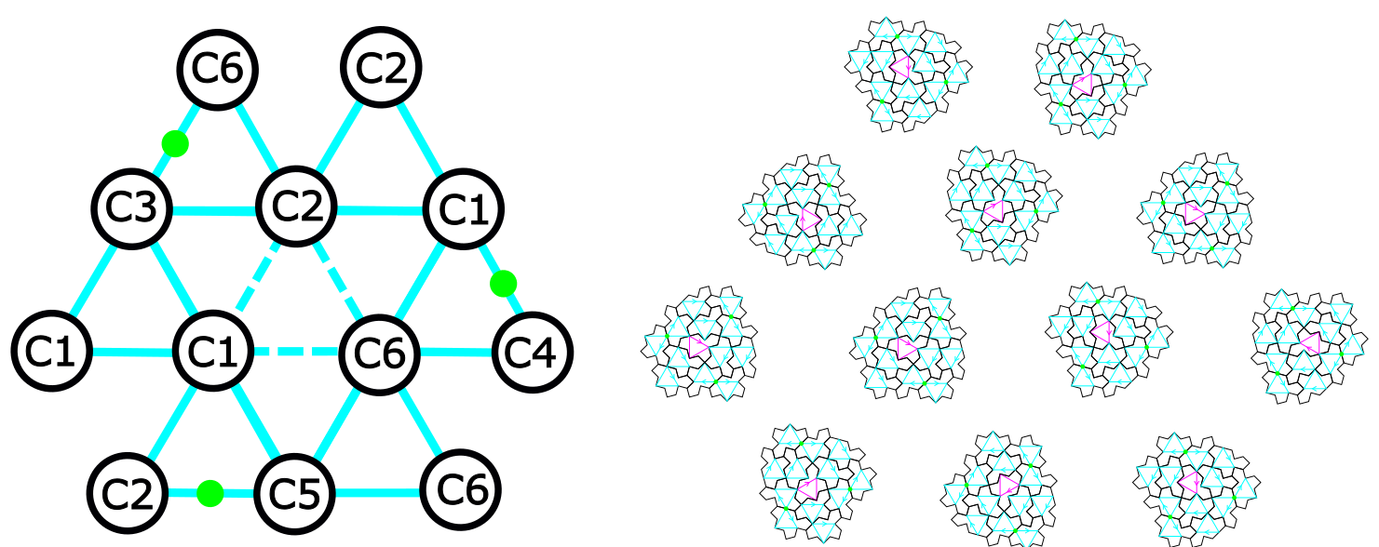
Inflation step 1
Directions along the blue lines are the edge directions of the blue triangles !!!

Slide 48
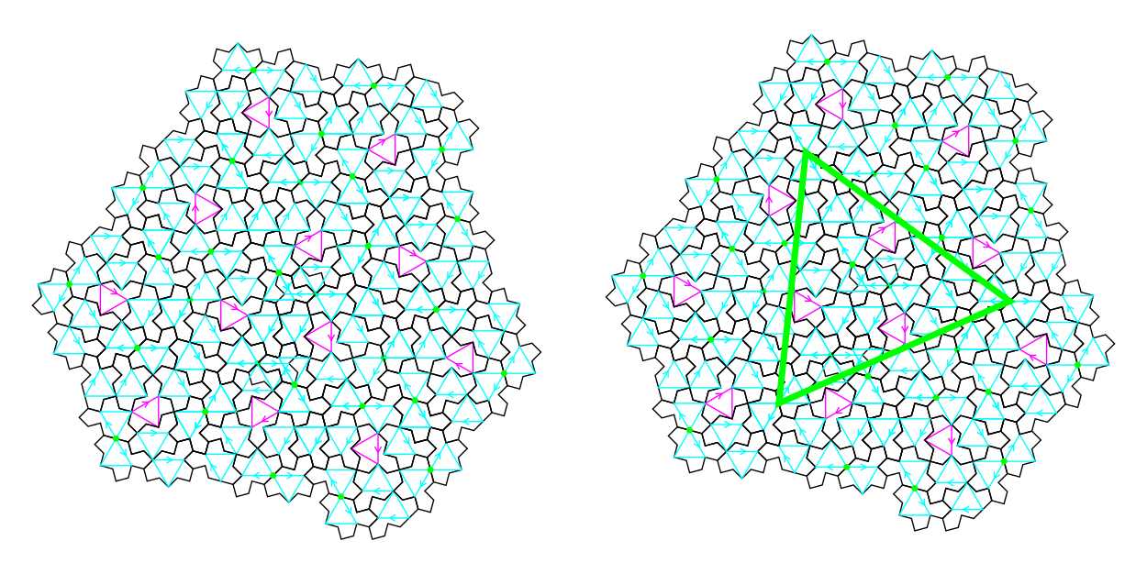
Inflation step 1 for full cluster C1
Assembly of the 12 full clusters works fine !!! (done manually so far for the relative positions of clusters)
Some tiles are superimposed
Some half-turned tiles need to be removed with a simple rule: translation wins over half-turn !
A bigger green triangle is identified, centered on a trifle at the center of the figure ☺

Slide 49
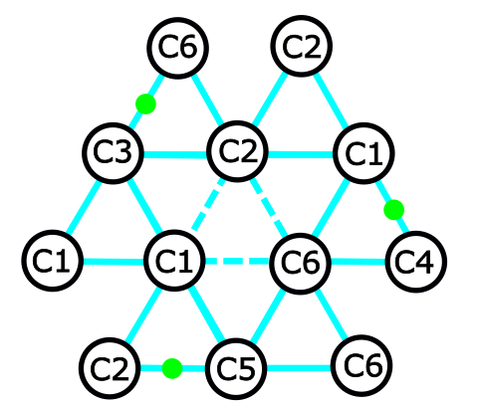
Inflation step 1 for full cluster C1
TO DO: Find a rule for the relative positions between clusters in the assembly
Clusters are translated from each other along the blue lines
Use superposition of green points from two adjacent clusters ???

Slide 50
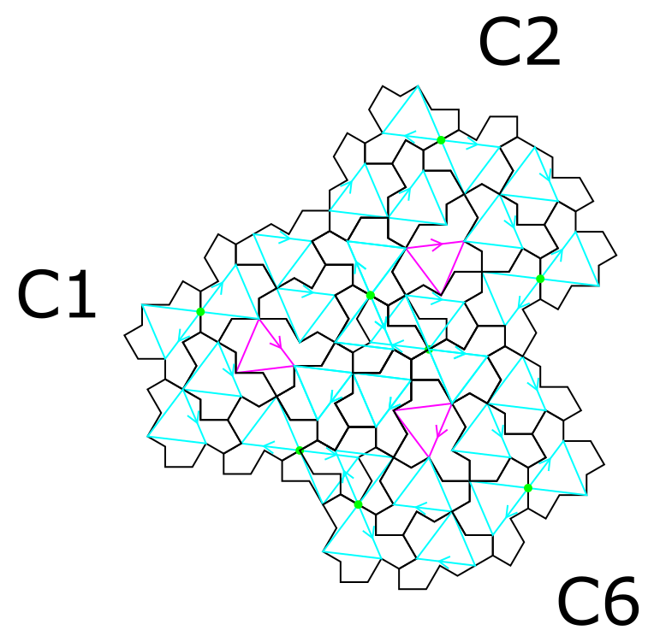

Defect healing
Starting point for worms ☺
After removing two half-turned tiles

Slide 51


Defect healing
Starting point for worms ☺
After removing two half-turned tiles

Slide 52
TO DO: Step 2
Replace all the 12 full clusters in this pattern with the same rule used previously for C1 (just a rotation of the pattern for C2, C3, C4, C5 and C6)

Slide 53


New reference triangle in Tile(a,b)
Robust for any T(a,b) tile ☺
a=1.6
b=1.2

Slide 54

Link with trifle and bow-tie in Tile(1,1)

Slide 55

Comparison with hexagon/square/rhombus decomposition

Slide 56

Tile(1,1) : spectre tile

Slide 57

translation versus half-turn for any Tile(a,b)
a=1.6
b=1.2

Slide 58

Cluster and full cluster
a=1.6
b=1.2
C cluster
(corona around a ODD tile)
The three translated tiles are all in the tiling
Three more possible tiles with half-turn around the green points

